Slide 1
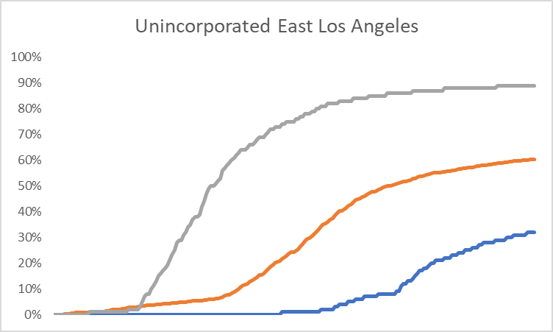
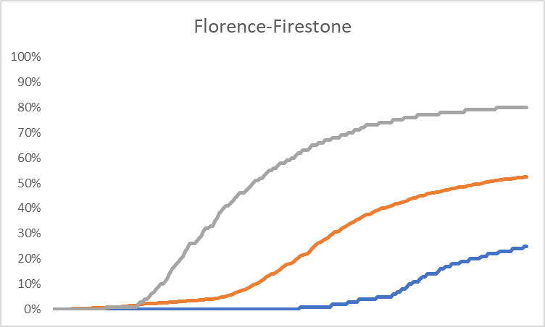
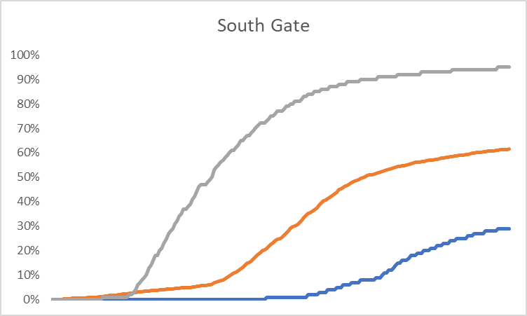
What is the variation in uptake of the vaccine (Dose 1) by age group, across areas? Do teens reflect community uptake? Where do patterns differ?
65+
16-64
12-17
% of residents vaccinated (12/1/21 through 7/11/21)
Data source: LAC DPH

Slide 2
How do actions affect rates? What progress is needed to achieve goals?
Cumulative percent of Crenshaw residents receiving vaccine (Dose 1)
LA City vaccine centers open to 16+
LA County vaccine centers open to 16+
First California vaccine lottery
Downey and The Forum vaccine centers close
Small sites open (Ted Watkins, Commerce, Norwalk)
Pfizer EUA for age 12+
Last day of school (LA Unified)
Instruction starts
Age 65+
Age 16-64
Age 12-17

Slide 3
How do actions affect the number of Crenshaw residents receiving the vaccine (Dose 1)?
First California vaccine lottery
Downey and The Forum vaccine centers close
Small sites open (Ted Watkins, Commerce, Norwalk)
LA City vaccine centers open to 16+
LA County vaccine centers open to 16+
Pfizer EUA for age 12+
Last day of school (LAUSD)
Age 12-17
Age 16-64
Age 65+

Slide 4
% of residents receiving Dose 1 in LA cities/neighborhoods, as of July 11, 2021
Average % in cities/neighborhoods
Upper and lower control limit
% in city/neighborhood
In each chart, cities/neighborhoods ordered from left to right by population size
Data source: LA County DPH
Notes:
Note: 12-17 chart includes areas with more than 100 residents of this age, 16-64 chart includes areas with more than 200 residents of this age, 65+ chart includes areas with more than 100 residents this age

Slide 5
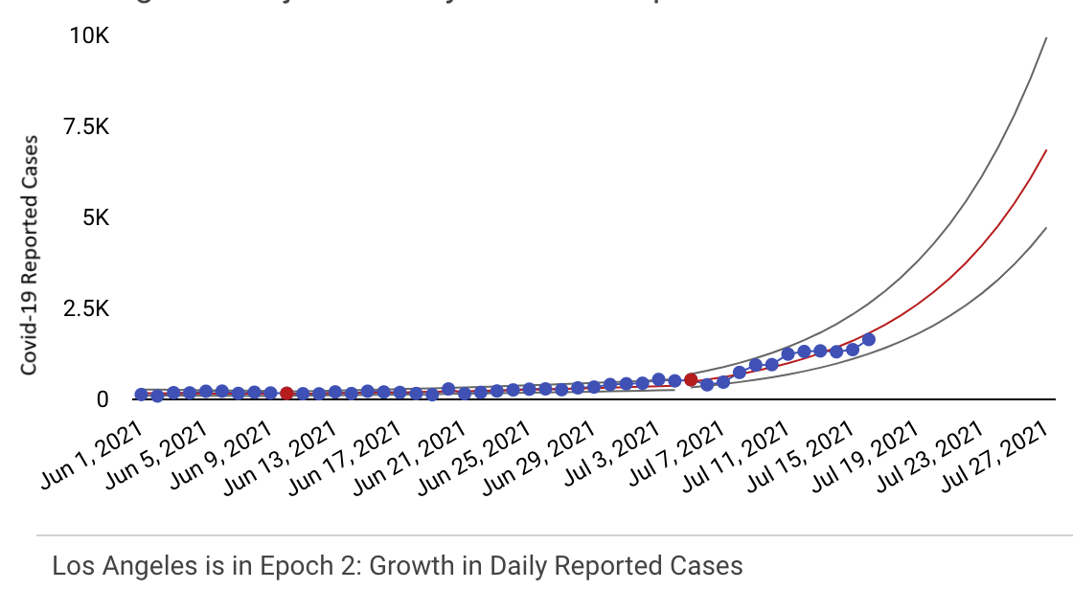
What are the earliest signals that a rate has changed, or switched between linear and exponential growth? (Example is daily COVID-19 cases in LA County)
https://datastudio.google.com/u/0/reporting/73d854a3-bc4c-4cbc-b830-bf9da16d54ed/page/brFsB
Notes:
Early warning of a shift – either a linear shift or a change from a stable rate to a growth (exponential) rate. Don’t want to miss a week to be aggressive on the policies. By havng reliable denominator, can react quickly with policies. This helps you see right away something that otherwise takes time. Also, importance of a denominator so that there’s no time wasted wondering if this is an artifact of who sought testing. Need to have real signals from data.

